Slide 1
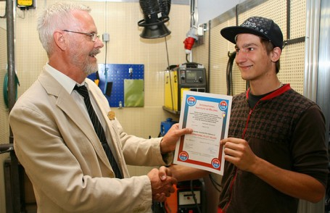
Läget 6 november 2019 för utbildningen Internationell svetsare
6238 Internationella diplom utfärdade
77 godkända utbildare
  23 Gymnasieskolor
  52 Arbetsmarknads-
  utbildare
  2 YH-utbildare

Slide 2
Utfärdade IW-diplom i Sverige
Totalt 6238 IW-diplom

Slide 3
Revisionsförslag Guideline IW
As decided during our IAB WGA#3a meeting in Bratislava in July 2019, a new Part III for the International Welder Guideline that will cover the option of welder qualification for welders that has experience in the field of welding has been created. It was also agreed that the “new” part III document will be circulated in November 2019 for your comment(s).
Please go through the attached document and give comments and inputs from your side – keeping in mind that we want to increase the numbers of qualified welders worldwide to the IAB 089 guideline.

Slide 4
Revisionsförslag Guideline IW
  Ny del III av guidelinen
För erfarna, minst 3 års erfarenhet, konstruktions- (structural welder) eller rörsvetsare (pipe welder).
Skall bara lägga proven
Kombination TIG + MMA för rörsvetsning

Slide 5
Revisionsförslag Guideline IW

Slide 6
Revisionsförslag Guideline IW

